Slide 1
Managing Entity Relationships
Chapter 5

Slide 2
Relational databases
When building enterprise applications, developers use relational databases to store business data created and updated using the application.
Application data typically spans multiple database tables, so it is common for data in one table to need to reference data in another.
When representing database tables in Java EE, developers use entity beans, one for each table.
To create a relationship between two entities, class-level variables are used to represent an instance of one entity as an attribute of another entity.

Slide 3
Use annotations
After the entity relationships are properly represented using class-level variables on the entity beans, developers use annotations to control JPA and properly map those entities and their relationships when retrieving data from the database.

Slide 4
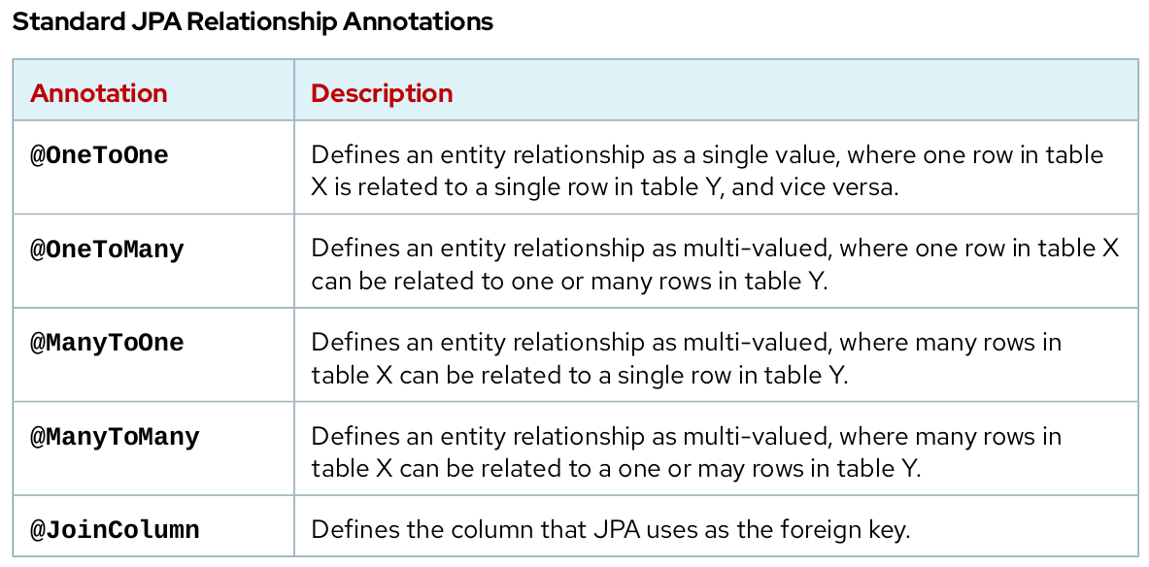

Slide 5
One-to-one Entity Relationship
Use the @OneToOne annotation when two entities relate to each other such that an instance of one entity only relates to a single instance of the other entity.

Slide 6
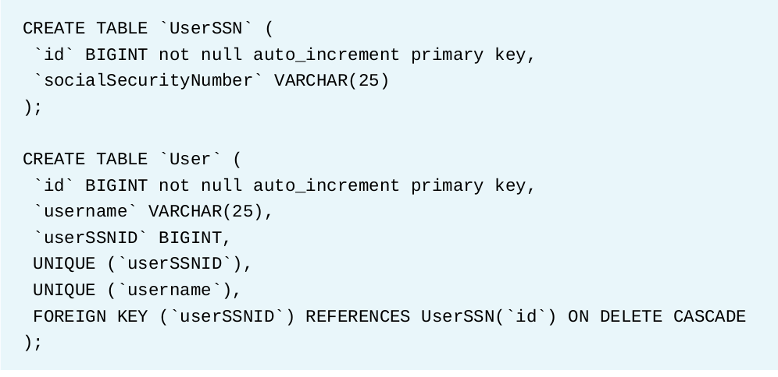
One-to-one Entity Relationship

Slide 7
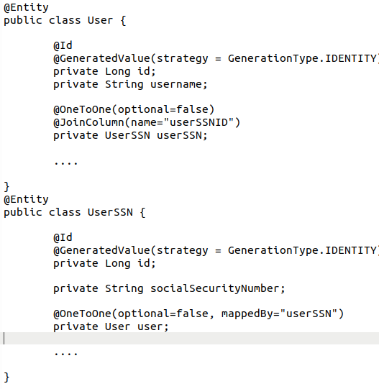
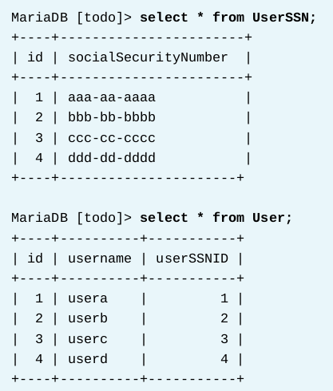
DB Schema

Slide 8
One-to-many Entity Relationship
Use the @OneToMany and @ManyToOne annotations to map a JPA relationship anytime two entities relate to each other such that one instance of one entity relates to potentially multiple instances of the other entity.

Slide 9
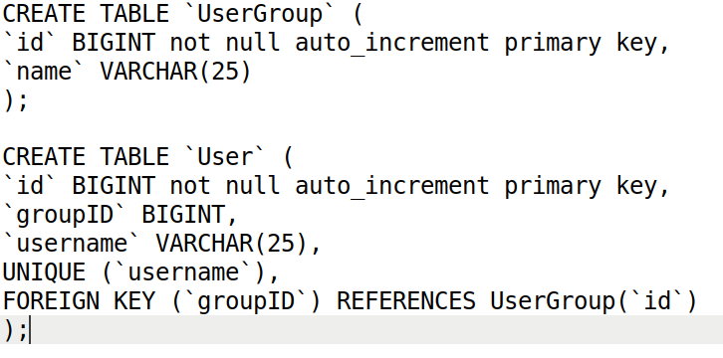
One-to-many Entity Relationship

Slide 10
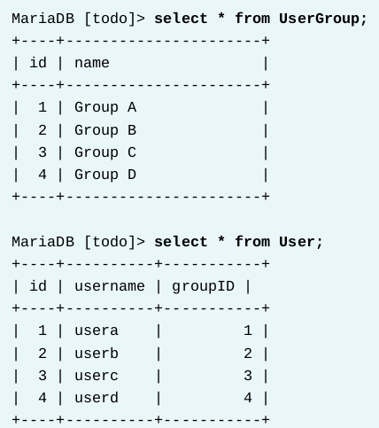
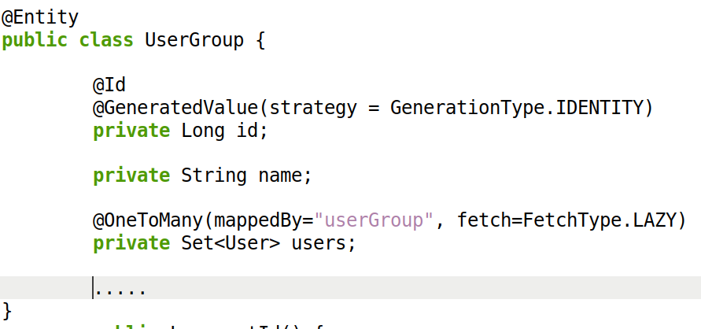
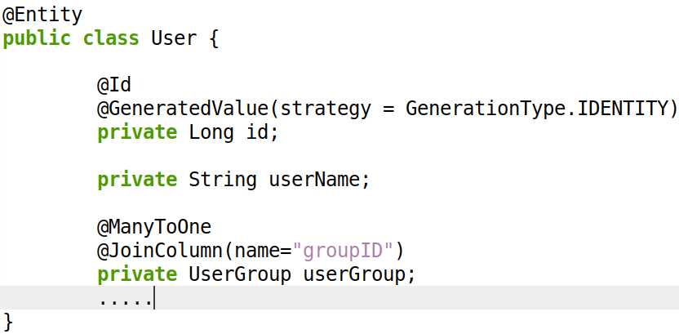

Slide 11
Tuning the Performance of Loading Relationship Data
Nesting relationships or complex database schemas with lots of relationships can be especially harmful to performance, as sometimes multiple queries must be executed to retrieve necessary data, or complex joins must be used. It is also very easy to use JPA to retrieve more data than intended, especially if every relationship is mapped bidirectionally on both entities.

Slide 12
Tuning the Performance of Loading Relationship Data
Consider a scenario where an application is storing automobile data. There are entities for Make, Model, SubModel, and Car. Each of these entities has a relationship to each other. For each Make, there are many Model instances, and for each Model there are many SubModel instances.
Additionally, the car entity has @ManyToOne relationships to each of these entities.

Slide 13
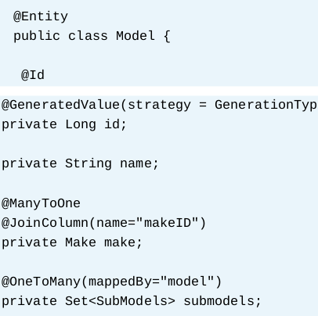
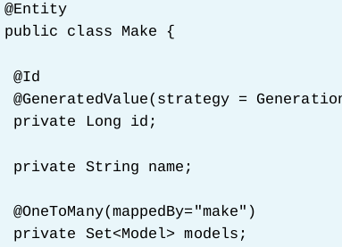

Slide 14
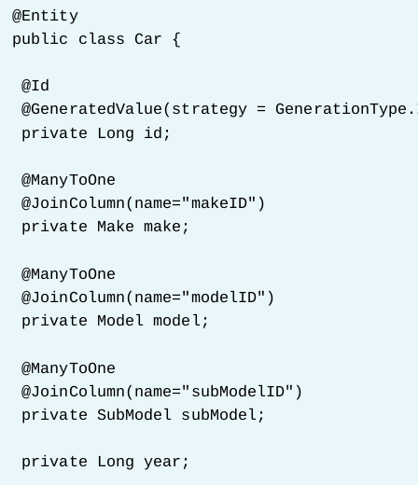
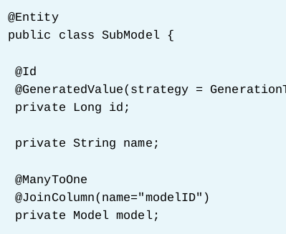

Slide 15
Using Lazy-Loading to Improve JPA Performance
Even if one entity has a relationship mapped to another entity with JPA annotations, it is not always necessary to retrieve that related entity when loading the data for the first entity from the database. This depends on the business logic that processes the instance of the entity being loaded. For example, different screens in an application might require different amounts of information required to display or have different performance requirements.

Slide 16
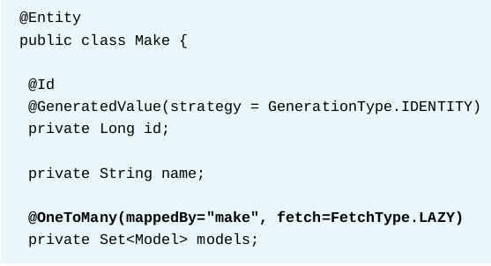
Lazy fetch

Slide 17
Guided Exercise – Page 214
[student@workstation ~]$ lab entity-relationships setup
https://rha.ole.redhat.com/rha/app/courses/ad183-7.0/e25f4717-0494-4858-98d2-a93391a0cd40/pages/ch05s02

Slide 18
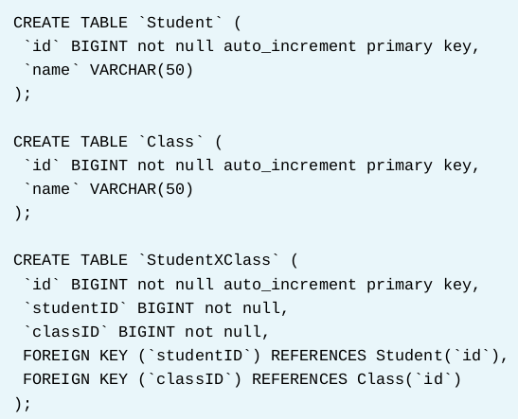
Describing Many-to-many Entity Relationships

Slide 19
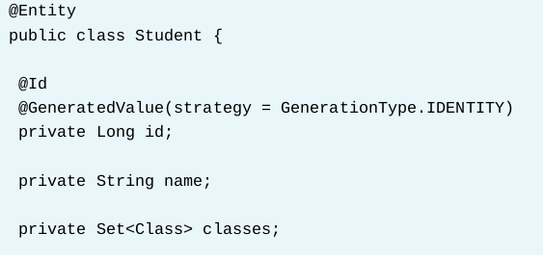
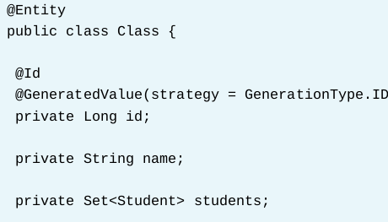
Many-to-Many

Slide 20
Using JPA Annotations to Map Many-to-many Relationships
Instead of using a single @JoinColumn JPA, use a @JoinTable annotation and two @JoinColumn annotations to map a many-to-many relationship. The @JoinTable annotation is the bridge that allows JPA to use the join-table to populate the relationships between two objects, and the two @JoinColumn annotations are used to define how to join the join-table back to the entity table, as well as to the related entity table.

Slide 21
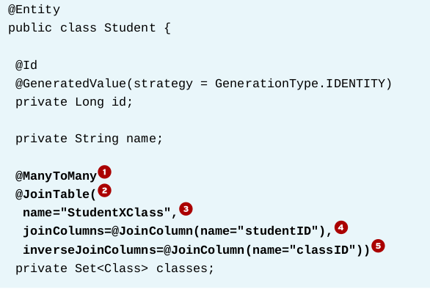
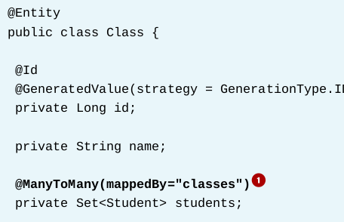
JPA Many-to-Many

Slide 22
Lab Task 1 – Page 231
[student@workstation ~]$ lab manage-relationships setup
https://rha.ole.redhat.com/rha/app/courses/ad183-7.0/e25f4717-0494-4858-98d2-a93391a0cd40/pages/ch05s05

Slide 23
Creating REST Services
Chapter 6

Slide 24
Web Services
Web services expose standardized communication for interoperability between application components over HTTP.
By abstracting applications into individual components that communicate across web services, each system becomes loosely coupled to each other.
This separation provides a greater ability to modify applications or integrate new systems into the application.
Using a standard format for data transfer, such as JSON or XML, allows applications that consume web services to require only the ability to make an HTTP request to the service and to process the service's response.

Slide 25
Webservices application architecture

Slide 26
Types of Web Services
JAX-RS RESTful Web Services
JAX-WS Web Services

Slide 27
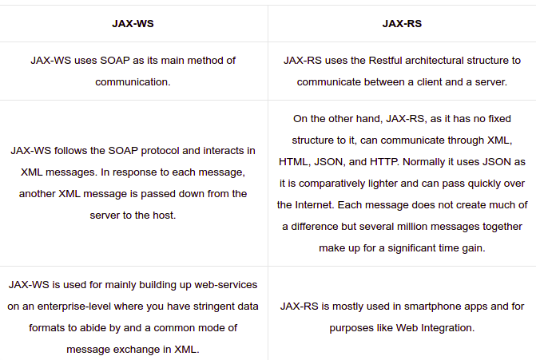

Slide 28
RESTful Web Services with JAX-RS
JAX-RS is the Java API used to create RESTful web services.
By implementing a web service layer, developers can abstract the front-end layer and create an application comprised of many loosely coupled components.
This type of architecture is known as a client-server architecture, and it is a requirement for REST web services.

Slide 29
Example: Call and Response
API call:
curl localhost:8080/todo/api/items/1
[student@workstation todojee]$ curl localhost:8080/todo/api/items/1
Json response:
{"id":1,"description":"Pick up newspaper","done":false,"user":null}

Slide 30
What’s next?
Create REST services with JAX-RS.
Consume REST web services.
Differentiate HTTP methods.

Slide 31
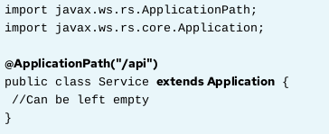
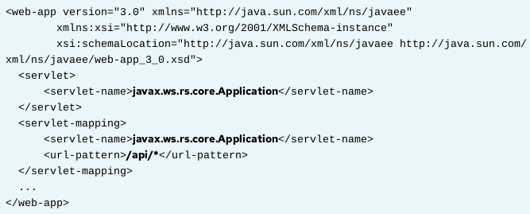
Creating RESTful Web Services - step 1

Slide 32
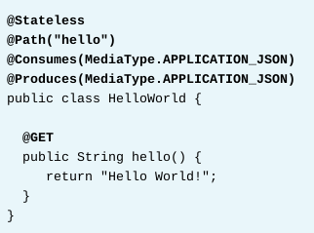
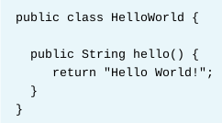
Creating RESTful Web Services - step 2
Basic pojo class - Before
RESTful web service - After

Slide 33
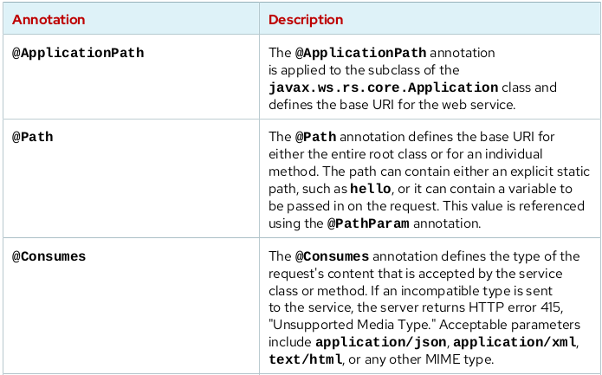

Slide 34
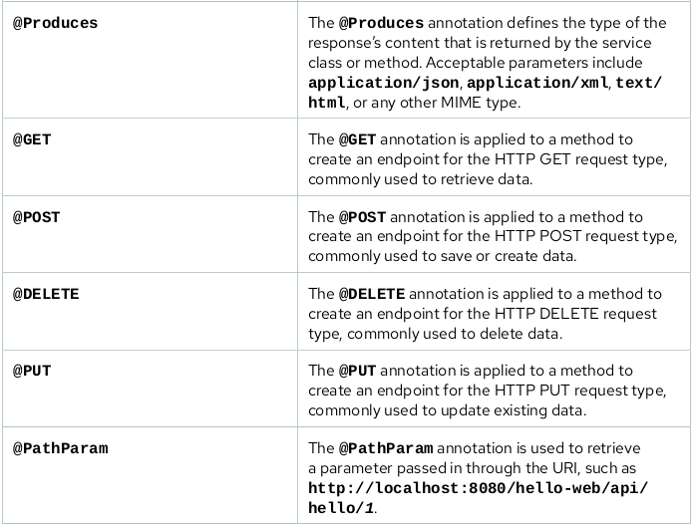

Slide 35
Http method
GET: The GET method retrieves data.
POST: The POST method creates a new entity.
DELETE: The DELETE method removes an entity.
PUT: The PUT method updates an entity.

Slide 36
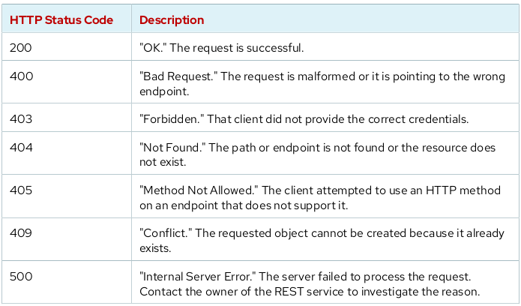

Slide 37
Guided Exercise – Page 255
[student@workstation ~]$ lab hello-rest setup
https://rha.ole.redhat.com/rha/app/courses/ad183-7.0/e25f4717-0494-4858-98d2-a93391a0cd40/pages/ch06s04

Slide 38
Consuming REST Services
While curl and other basic HTTP request approaches offer a simpler and faster approach for interacting with and testing a REST service, many developers prefer to use language-specific libraries to programmatically interface with REST services to provide greater functionality and control of the requests and responses
Client: The client creates instances of WebTargets.
WebTarget: The URL destination of a REST endpoint.
Response: The object containing the response from the service.

Slide 39
Calling GET API
Client client = ClientBuilder.newBuilder().build();
WebTarget webTarget = client.target("http://localhost:8080/todo/api");
WebTarget itemTarget = webTarget.path("items/{id}").resolveTemplate("id", "1");
Response response = itemTarget.request().get();
Item foundItem = response.readEntity(Item.class);
client.close();

Slide 40
Calling API with Authentication
String username = "redhat";
String password = "Shadowman";
String userpass = username + ":" + password;
String encodedCred = new BASE64Encoder().encode(userpass.getBytes());
Client client = ClientBuilder.newBuilder().build();
WebTarget webTarget = client.target("http://localhost:8080/todo/api");
WebTarget itemTarget = webTarget.path("items/{id}").resolveTemplate("id", "1");
Response response = itemTarget.request().header("Authorization", "Basic " +
encodedCred).get();
Item foundItem = response.readEntity(Item.class);
client.close();

Slide 41
Lab Task 2 – Page 269
[student@workstation ~]$ lab todo-rest setup
https://rha.ole.redhat.com/rha/app/courses/ad183-7.0/e25f4717-0494-4858-98d2-a93391a0cd40/pages/ch06s07

